Slide 1

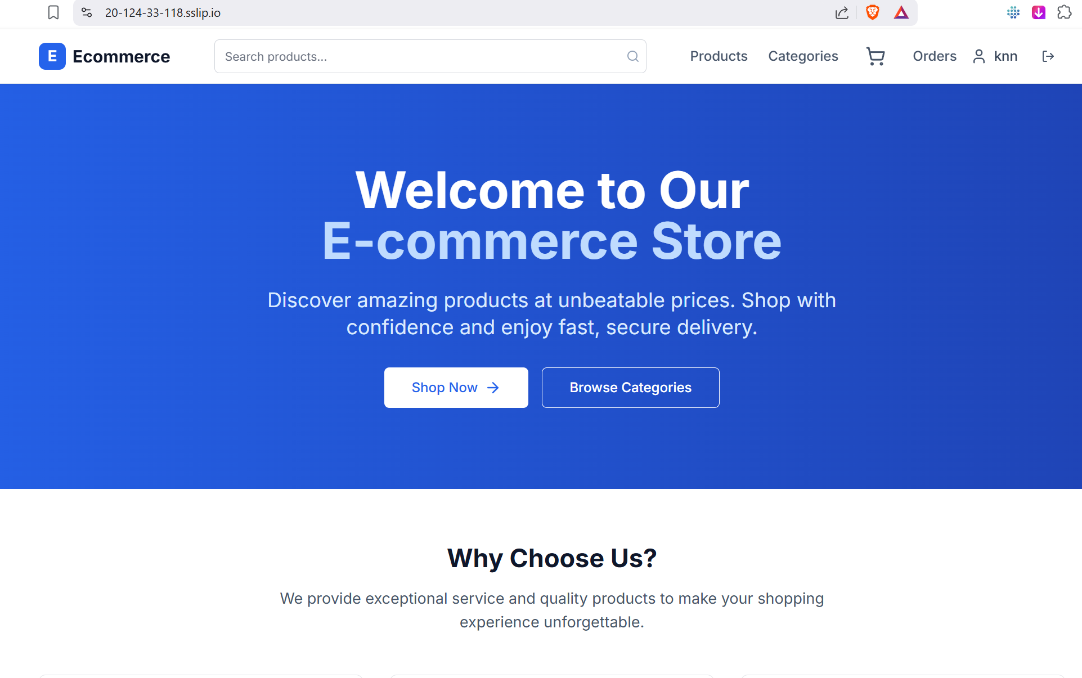


Azure 3-Tier E-Commerce Application
01
Azure 3-Tier
E-Commerce Application
Frontend + Backend + Database on Azure
Secure (HTTPS & Routing)
Scalable (Autoscaling)
Monitored (Logs & Alerts)
Team : Kenan Salmanli, Mahammad Mammadov,
Fidail Valiyev , Yusif Vatanli

Slide 2
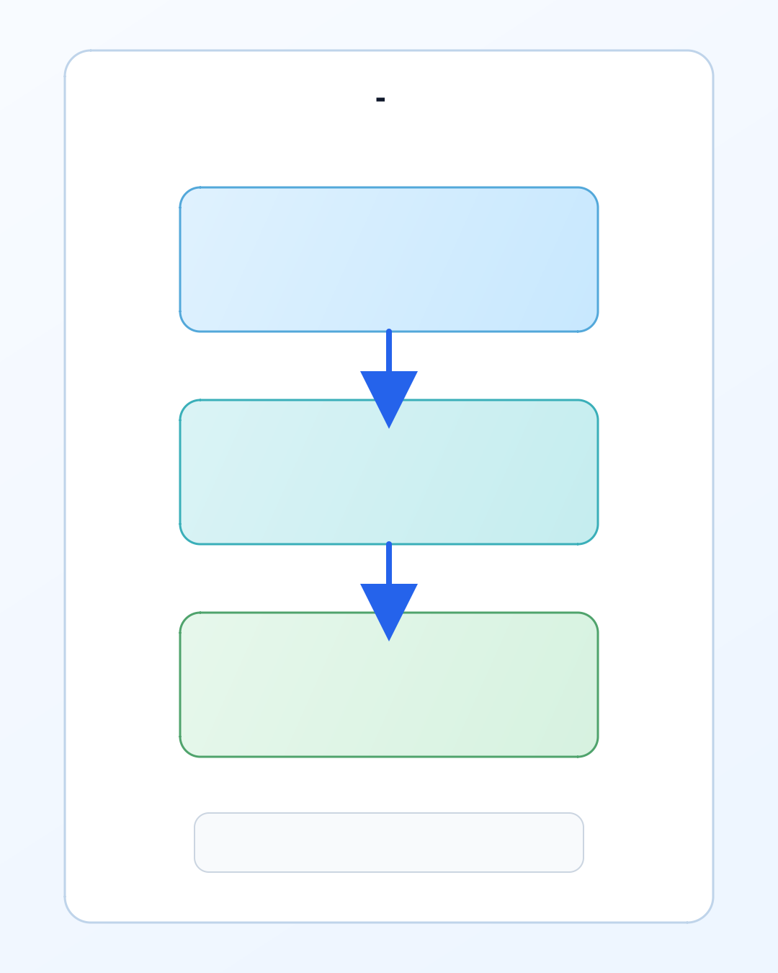



Azure 3-Tier E-Commerce Application
02
What is 3-Tier Architecture?
Presentation Layer
Frontend UI serving the user interface
Application Layer
Backend API processing business logic
Data Layer
Azure SQL Database for data storage

Slide 3
Azure 3-Tier E-Commerce Application
03
Project Overview
What We Built
We deployed a production-grade three-tier e-commerce application on Microsoft Azure, consisting of a React frontend, a Node.js/TypeScript Express backend, and an Azure SQL Database — all running behind an Azure Application Gateway with HTTPS and path-based routing.
The application is fully containerized and runs on Azure Container Apps within a private virtual network, not directly exposed to the public internet.
Objectives were:
Deploy a real multi-tier application on Azure using industry-standard infrastructure
Implement secure, private networking between components
Configure HTTPS termination and intelligent routing at the gateway layer
Apply monitoring, alerting, and load testing practices used in production environments

Slide 4
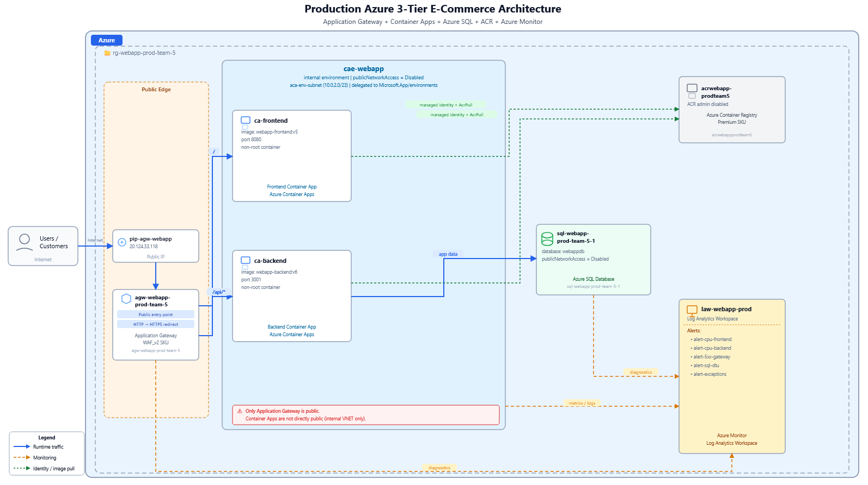


Azure 3-Tier E-Commerce Application
04
Full Azure Architecture
Public Entry
Azure Application Gateway
App Tier
Azure Container Apps
Data Tier
Azure SQL Database
Monitoring
Log Analytics + Alerts

Slide 5
Azure 3-Tier E-Commerce Application
05
Architectural details
Frontend: React app served by nginx, running in Azure Container Apps ports configured for both http and https
Backend: TypeScript/Express API, running in Azure Container Apps
Database: Azure SQL Database
Entry point: Azure Application Gateway v2 — HTTP→HTTPS redirect, path-based routing (/ → frontend, /api/* → backend)
Networking: Internal ACA environment on a private VNet subnet, with Private DNS zone for internal name resolution
Security: Container Apps not publicly exposed; all traffic flows through the Application Gateway

Slide 6
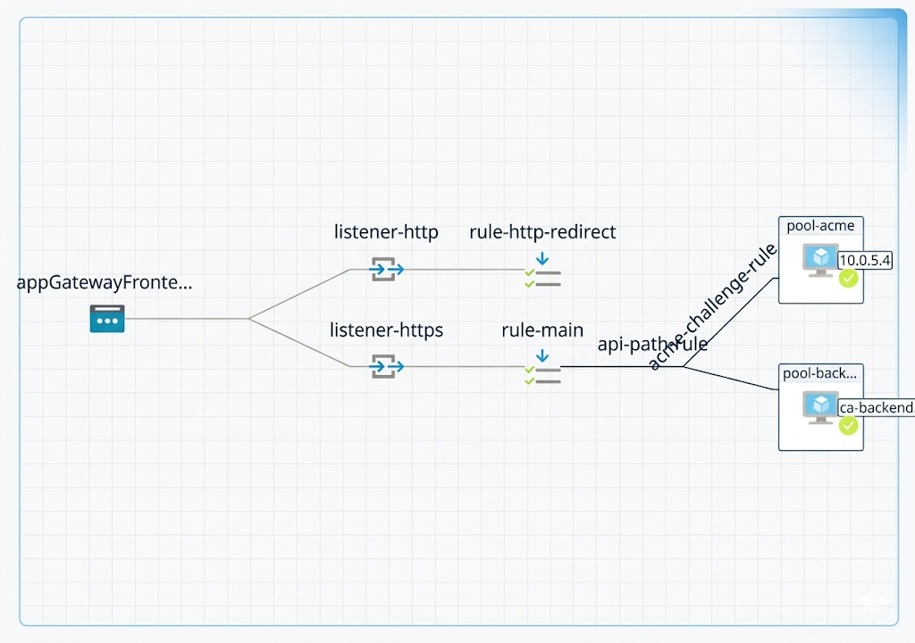
Azure 3-Tier E-Commerce Application
06
Request Flow in the App
1
User opens the website
2
Gateway routes traffic
Backend processes API requests
3
4
SQL stores and returns data

Slide 7
Azure 3-Tier E-Commerce Application
07
Implementation details
Infrastructure provisioning We provisioned a VNet with two dedicated subnets — one for the Application Gateway and one for the ACA environment. An internal Azure Container Apps environment was deployed into the ACA subnet, ensuring no container was directly reachable from the internet.
Container builds and deployment Both frontend and backend were containerized with custom Dockerfiles. Images were pushed to Azure Container Registry and deployed as Container Apps. Environment variables — including the Azure SQL connection string — were injected via App Settings rather than Key Vault secrets, a deliberate choice given access constraints during the project.
Application Gateway configuration We configured the gateway with two backend pools (frontend and backend), two HTTP settings with host override headers matching internal ACA FQDNs, custom health probes, a URL path map for routing, a self-signed TLS certificate for HTTPS termination, and an HTTP-to-HTTPS redirect rule.
Private DNS A private DNS zone matching the ACA environment domain was linked to the VNet, with A records pointing to the ACA environment's static internal IP. This allowed the Application Gateway to resolve internal container app hostnames correctly.

Slide 8


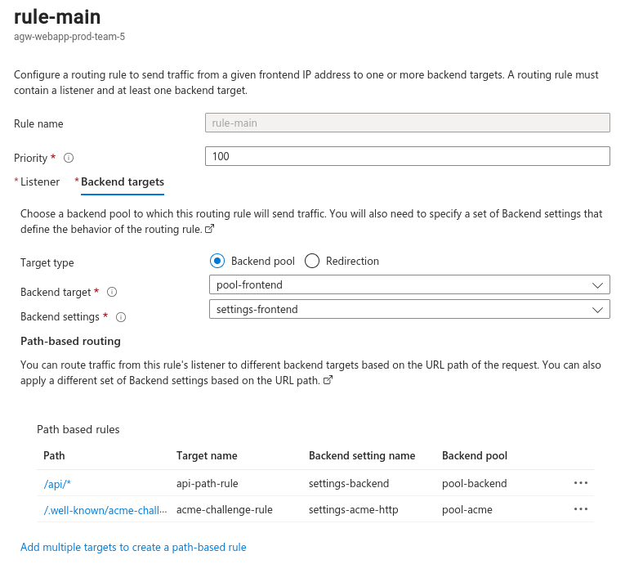
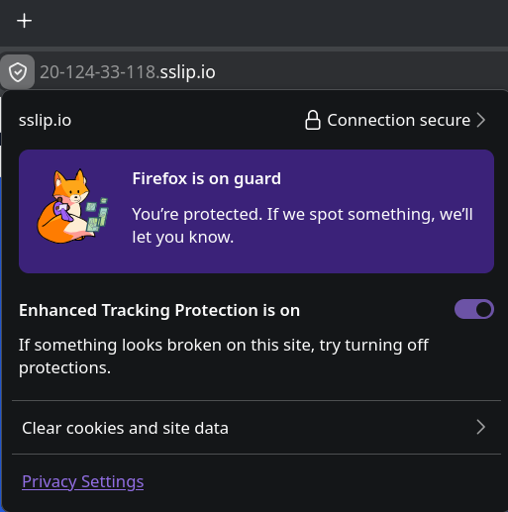



Azure 3-Tier E-Commerce Application
08
Routing Rules
Security & HTTPS
Single public entry point
Encrypted connection
/
→ Frontend
→ Backend
HTTP redirected to HTTPS
/api/*

Slide 9
Azure 3-Tier E-Commerce Application
09
Implementation details
Separation of concerns: Frontend, backend, and database each live in isolated layers with no direct cross-exposure
Host header overrides: Application Gateway sends the correct internal hostname in the Host header so ACA ingress routes requests to the right container app
Strict health probes: Custom probes target real valid paths (/index.html for frontend, /health for backend) so the gateway only routes to genuinely healthy backends
HTTPS only: HTTP listener redirects all traffic to HTTPS; TLS terminates at the gateway
Load testing: k6 scripts were written and executed to validate the system under simulated traffic
Alerting: Azure Monitor alerts configured for key signals — backend error rates, gateway latency, unhealthy backend count, and more

Slide 10
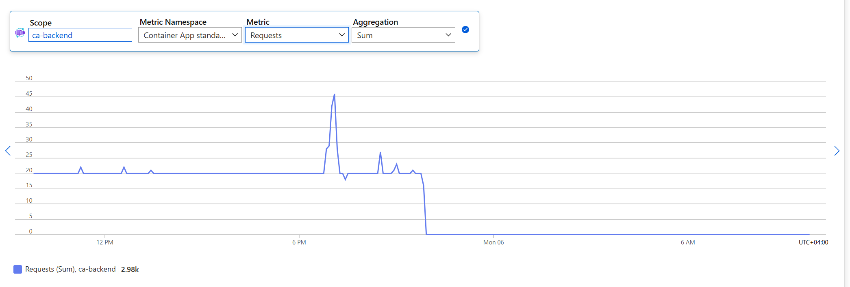
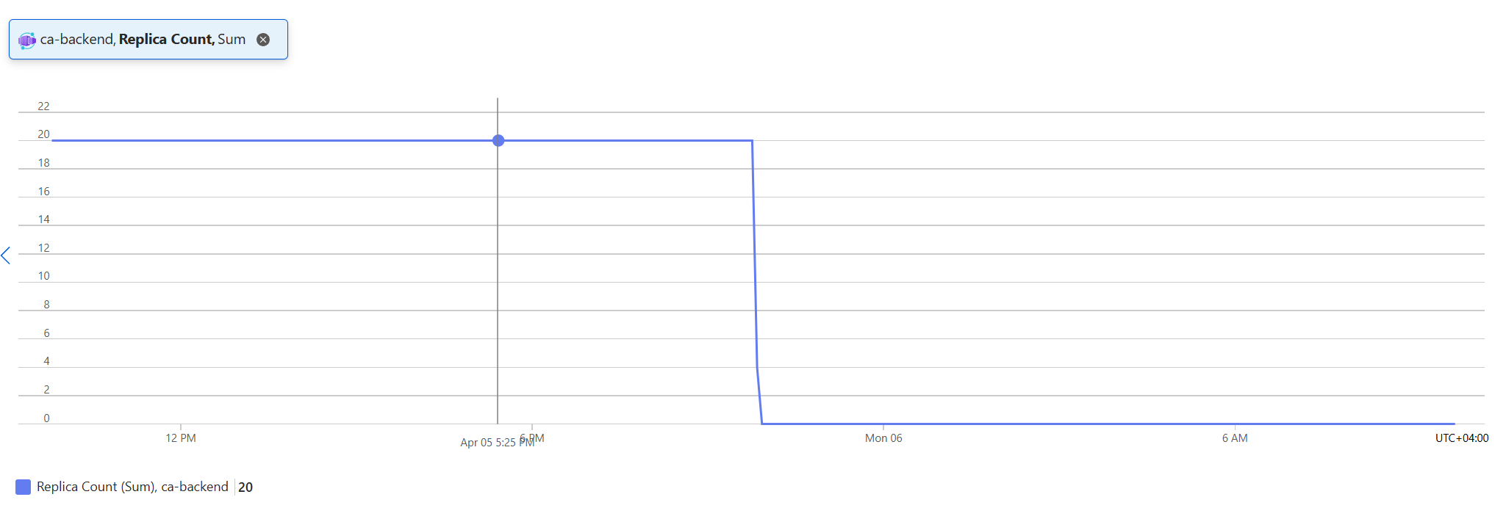
Azure 3-Tier E-Commerce Application
10
When Scaling Happens
Low Traffic
Fewer replicas running to minimize cost
High Traffic
More replicas auto-spawned to handle load
Load Test: Triggered scale-out
Traffic Drop: Triggered scale-in

Slide 11

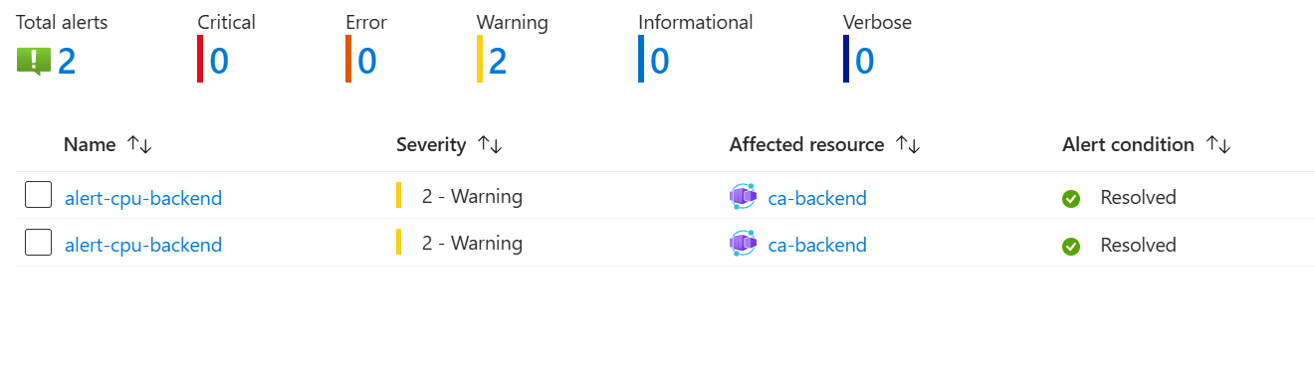

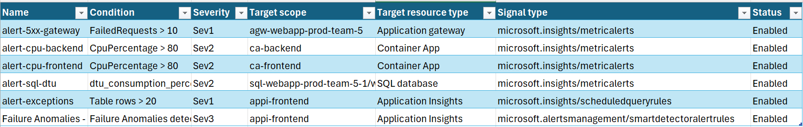
Azure 3-Tier E-Commerce Application
11
Security & Monitoring
Monitoring Alerts
CPU Usage
DTU Limits
Exceptions
5xx Errors
Network Security
Only Application Gateway is public
Container Apps environment is private
SQL public access is disabled

Slide 12
Azure 3-Tier E-Commerce Application
12
Challenge and solutions
Challenge: The frontend was making API calls to http://localhost:3001/api, which works in local development but obviously fails when deployed — the backend is a completely separate container.
Solution: We updated the frontend to use /api as the base URL, letting the browser send requests to the same origin (the Application Gateway), which then routes /api/* to the backend pool. No hardcoded hostnames anywhere.
Challenge: The backend Dockerfile was installing only production dependencies in the build stage, causing the TypeScript compilation step to fail silently because typescript and ts-node are devDependencies.
Solution: We reordered the Dockerfile to install all dependencies (including devDependencies) before compiling, then prune to production-only for the final image.

Slide 13
Azure 3-Tier E-Commerce Application
13
Major obstacle
Our biggest obstacle was that the application kept returning either 502 Bad Gateway or the ACA generic "This Container App does not exist" page, and the symptom looked the same regardless of which underlying issue was causing it.
At different points the same symptom was caused by four different root causes: wrong backend pool IP, incorrect host header, unhealthy probe rejecting a valid backend, and a frontend container that wasn't actually serving content on the expected path.
What we learned: When multiple components must work together simultaneously — DNS, gateway config, probe, ingress, application code — a single broken link produces an identical failure at the surface. We learned to isolate layers: test from inside the VNet first, then from the gateway, then publicly. This narrows the failure space dramatically.
What we'd do differently: We would write a pre-flight checklist — DNS resolves correctly? Probe path returns 200? Host header matches ACA ingress? — and verify each box before touching anything. Changing multiple things at once and then testing was consistently slower than fixing and verifying one thing at a time.

Slide 14
Azure 3-Tier E-Commerce Application
14
Teamwork and Collab
How We Worked as a Team
The project was divided by responsibility: each team member owned a specific layer — frontend, backend/database, and infrastructure/gateway. This division allowed parallel progress while keeping clear ownership.
What worked well: Having one person own the Application Gateway configuration end-to-end prevented conflicting edits, which is important given that the gateway has many interdependent settings (pools, HTTP settings, probes, rules) that break each other when edited inconsistently.
What could be improved: We underestimated the complexity of the networking layer early on, which led to some lost time debugging symptoms before identifying root causes. Establishing a "verify before assuming" discipline earlier — running CLI inspection commands before making changes — would have saved several debugging cycles.

Slide 15
Azure 3-Tier E-Commerce Application
15
Conclusion
By the end of the project we proudly can say:
A real three-tier application is deployed and accessible over public HTTPS
All traffic flows through the Application Gateway; no container is directly exposed
The backend connects to Azure SQL and the frontend communicates with the backend through the gateway's path-based routing
The system is monitored with real alerts and has been load-tested with k6
Every team member gained hands-on experience with the full Azure networking stack — not just deploying containers, but understanding how they communicate securely in a real architecture

Slide 16

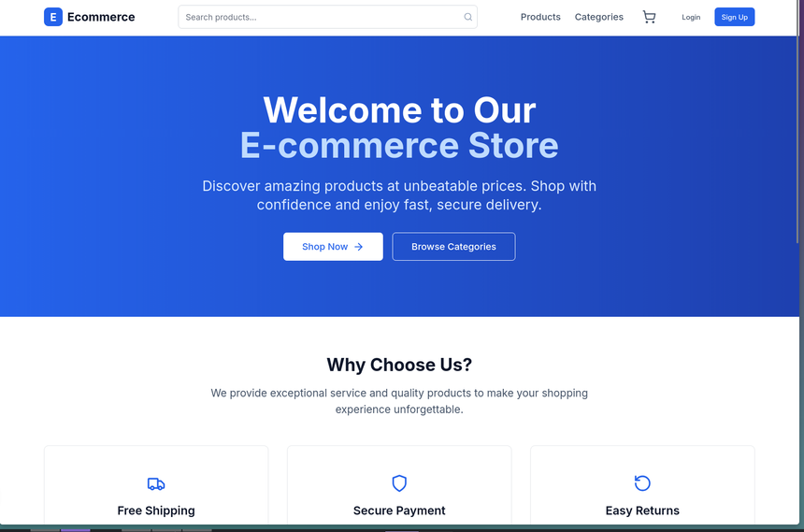
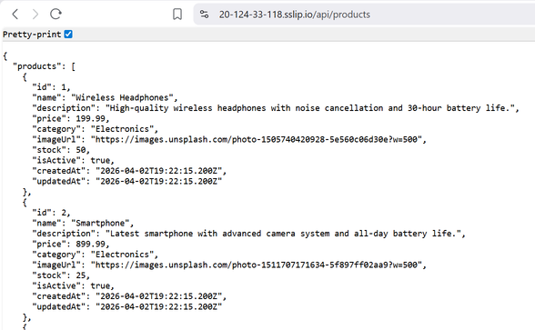
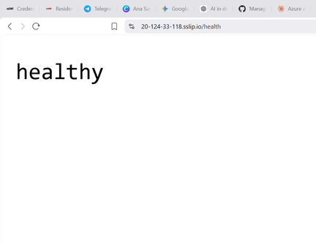
Azure 3-Tier E-Commerce Application
16
Result
Project Success
Autoscaling and monitoring verified
3-tier architecture implemented successfully
HTTPS and routing configured
Production-style Azure deployment completed

Slide 17

Azure 3-Tier E-Commerce Application
17
Thank you for your attention and the QR if u wanna check our deployed app

